Slide 1
COVID RESOURCE MANAGEMENT
3rd December,2021
Aarush Juneja 20124001
Lovepreet Singh 20124048
Naman Sharma 20124066
Shubham Shoor 20124095
Branch : Information Technology
2nd Year

Slide 2
ACKNOWLEDGEMENT
We would like to thank Dr Nisha Chaurasia And Pooja Sharma Ma’am for equipping us with appropriate knowledge and conceptual skills which resulted in successful completion of this project. Their guidance and teaching played an important role in overcoming the challenges that we faced along the way.
Efforts of the team members are also appreciated. The hard work they put in, and their consistency in fulfilling all the requirements of the project as well as keeping up the team spirit while performing together and their cooperation is greatly admired.

Slide 3
TABLE OF CONTENTS
01.
SUMMARY
02.
INTRODUCTION
03.
METHODOLOGY
04.
MISSION
Basic layout of the project.
Explaining the project.
Methods followed to complete the project.
Purpose served by the project.
05.
BIBLIOGRAPHY
Reference to the resources used.

Slide 4
01. SUMMARY
“Covid Resource Management” is a project that consist of Data-Base of 200 Renowned Private as well as Government Hospitals of India and primarily of 4 Metropolitan cities which are:-
Delhi, Kolkata, Mumbai and Bangalore.
Our Data-Base aims at catering the Covid needs of the people with help of quick and easy to use Terminal and well managed Relational Database.
We have used SQL, Python, Flask, HTML, CSS to
create user Friendly Interface.

Slide 5
INTRODUCTION
02.
Database comprises of in Total of 200 Renowned Hospitals, 50 in each of the following cities :-
Delhi, Mumbai, Kolkata and Bangalore
And contains information about their :-
Using the database, information about available beds, doses, ventilator, oxygen cylinder, blood can be extracted successfully with help of SQL .
Using Flask, HTML, Python & CSS, easy to use user interface has been developed.
Thereby helps in generating desire insights to serve patient’s request in meantime hence saving a lot of lives.
Location | Ownership | Contact | Ventilator
Registered ID | Blood Bank | Oxygen | Remdesivir
Vaccination Dose | Beds | Active Cases | Mortality Rate
Recovery Rate

Slide 6
METHODOLOGY We followed…

Slide 7
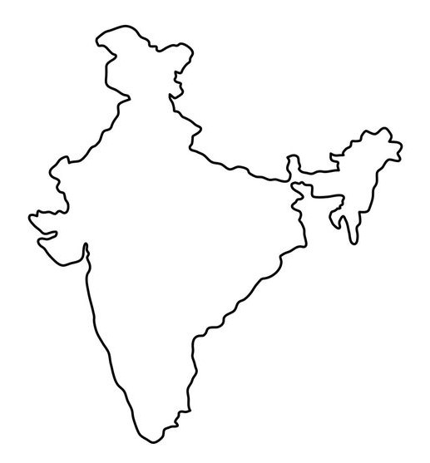
LOCATIONS
4 cities were divided among 4 members. One city each and were asked to web scrape data of 50 Hospitals, containing their Location, contact information, ownership (govt/private), ventilator, Beds Available etc.
Information about present active cases, mortality rate and recovery rate was also added in database with help of SQL queries in MySql Workbench to generate viable insights.
Various SQL queries were used to impose condition on the entered data to make it fit
for the Relational Database.
Various trusted sites were used to scrape the data from web.
Delhi
Kolkata
Mumbai
Bangalore

Slide 8
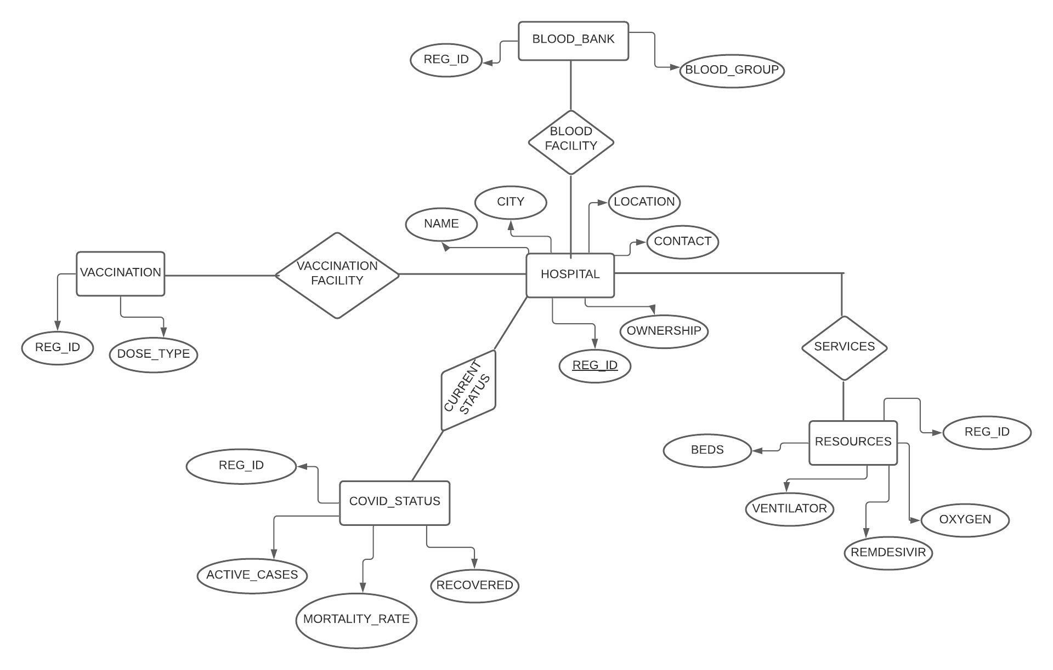
ER DIAGRAM :-
“COVID RESOURCE MANAGEMENT”
Database comprises of 5 tables:-
Here REG_ID has been used as a Primary key linking data of all tables together and acting as Foreign Key for other tables.
HOSPITAL table is linked to all other tables with specific defined relations such as Vaccination Facility,
Current Status, Blood Facility, Resources.
Their related attributes has been show in the figure :-
HOSPITAL | BLOOD_BANK | VACCINATION
RESOURCES | COVID_STATUS

Slide 9
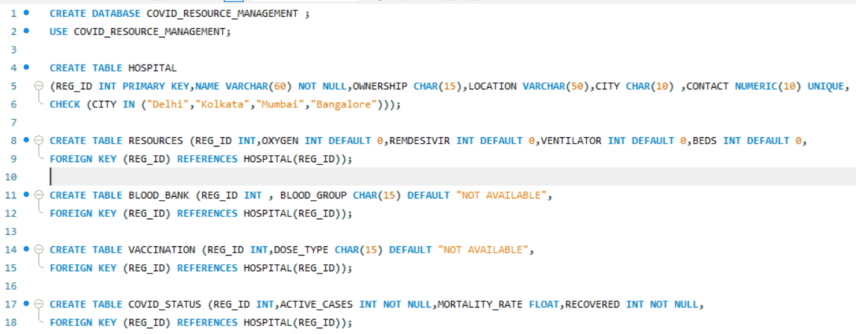
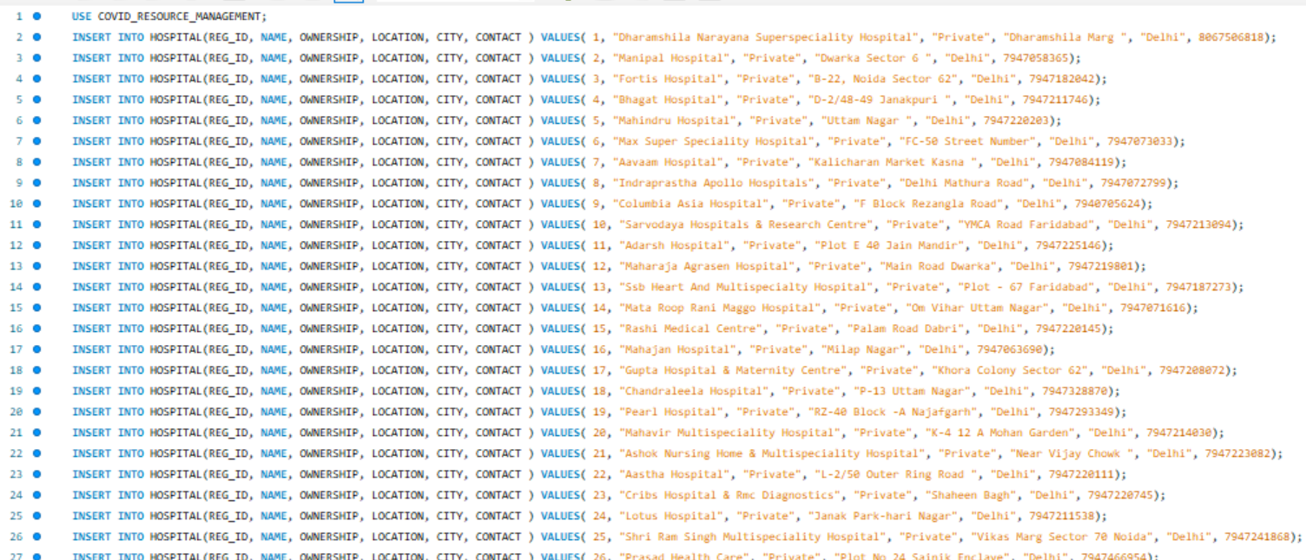
QUERIES USED TO CREATE DATABASE :
***
CREATING DATABASE AND TABLES
***
HOSPITAL TABLE
In total of 200 rows

Slide 10
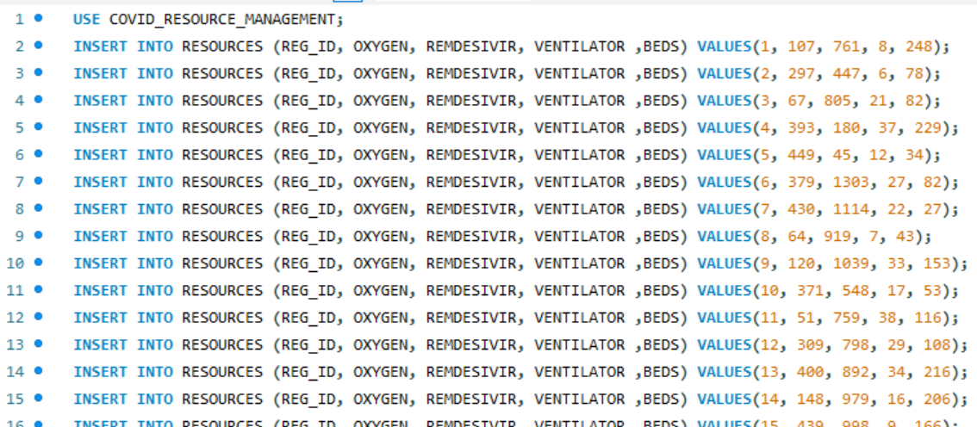
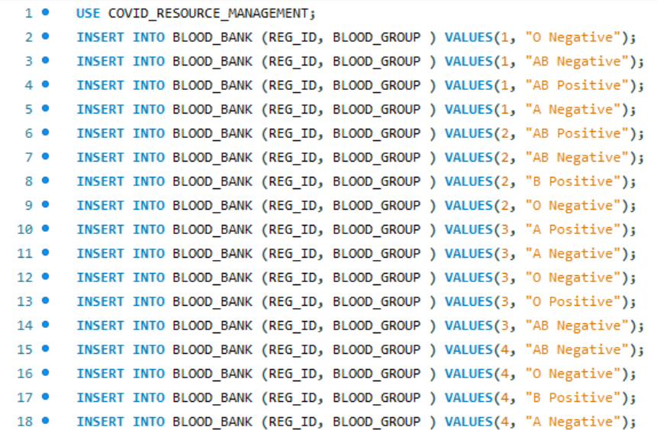
RESOURCES TABLE
In total of 200 rows
TABLE OF BLOOD_BANK
In total of 594 rows

Slide 11
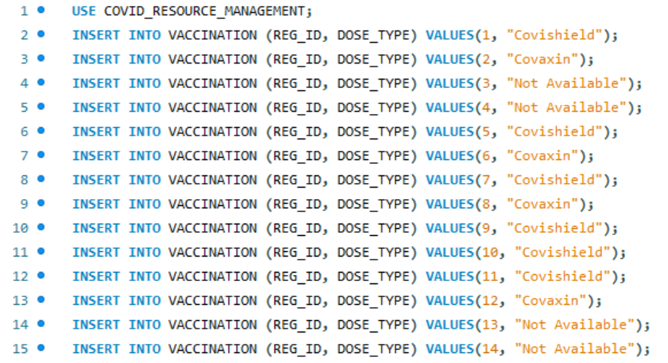
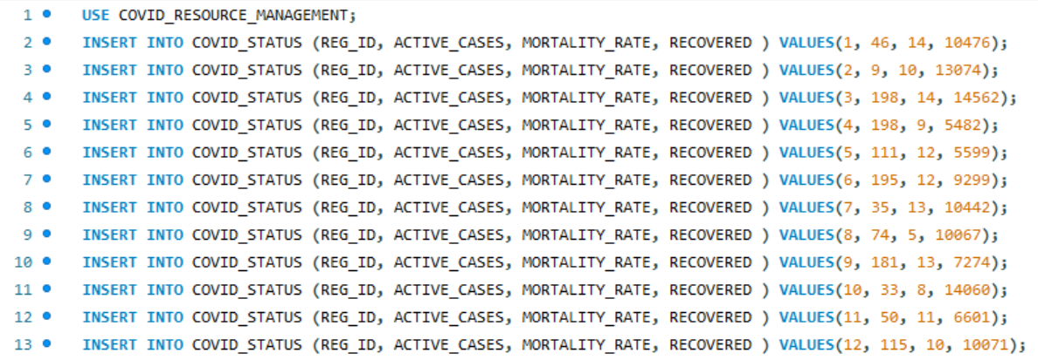
VACCINATION TABLE
In total of 200 rows
COVID STATUS TABLE
In total of 200 rows

Slide 12
MISSION
EXPLAINED WITH HELP OF SOME SAMPLE QUERIES

Slide 13
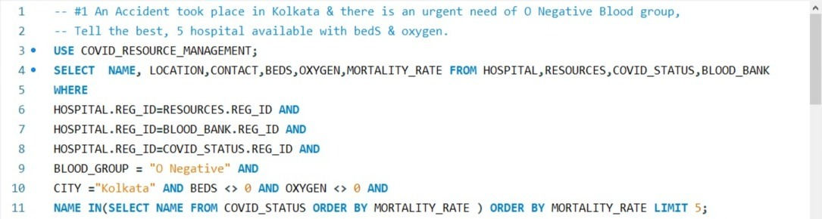
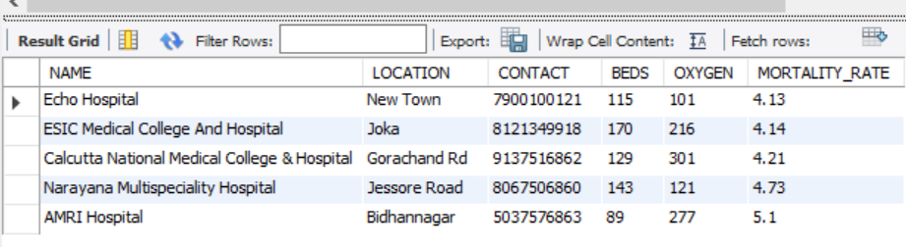
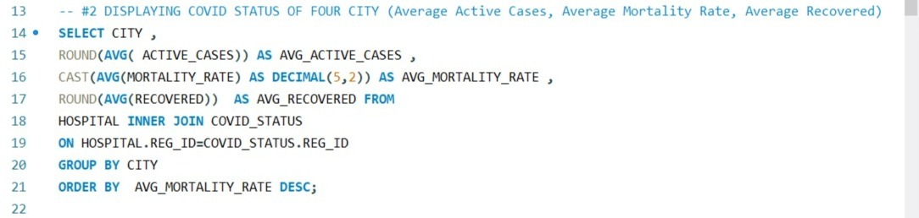
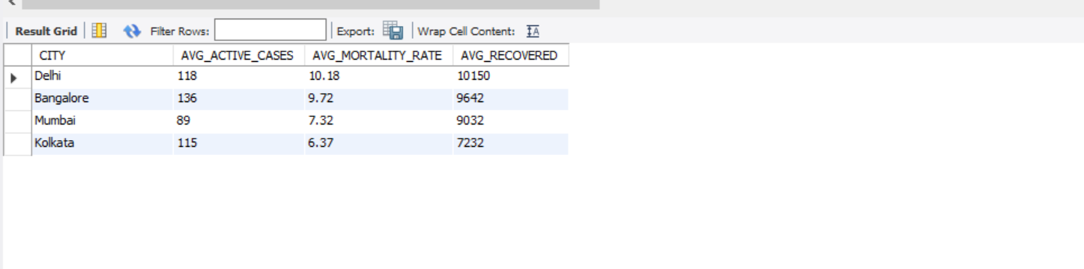
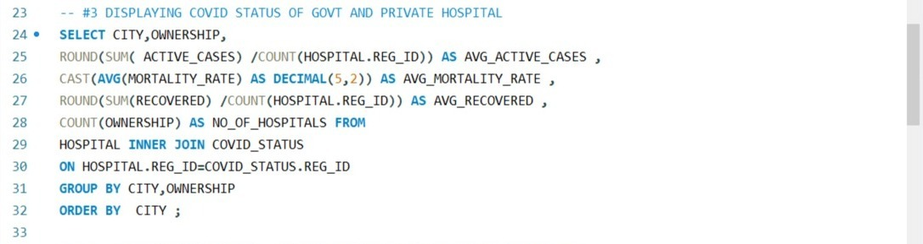
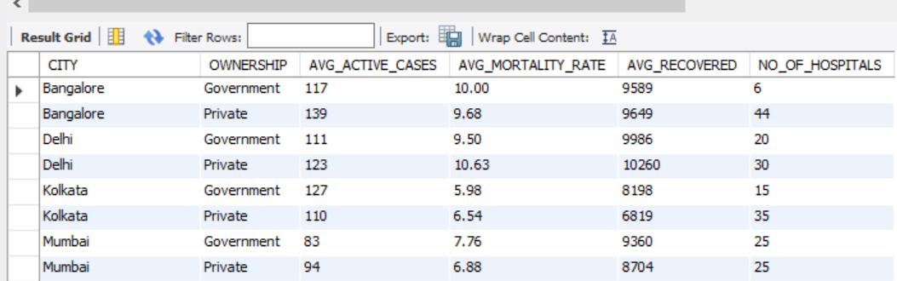

Slide 14
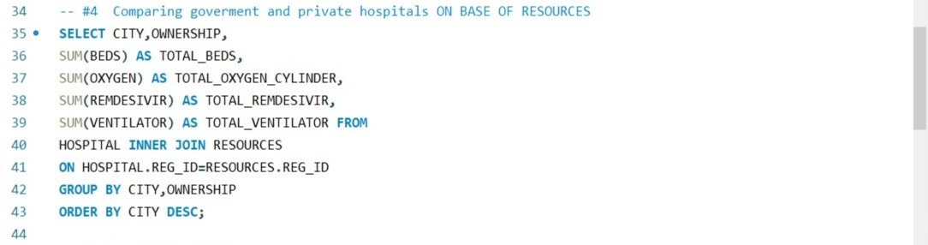
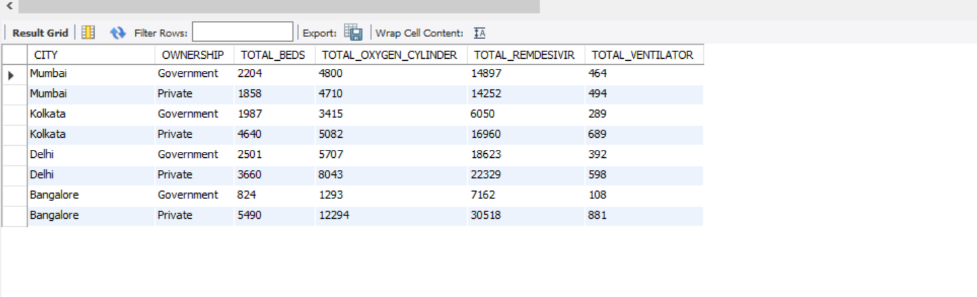
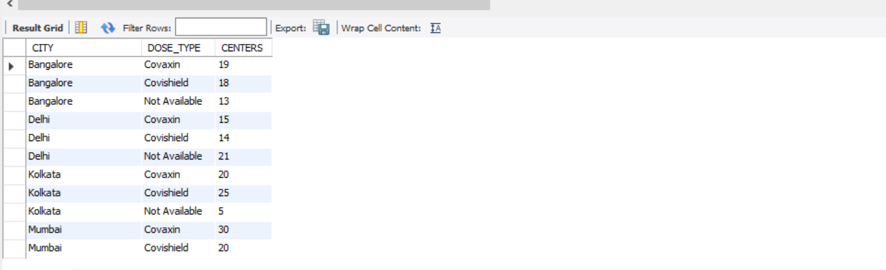
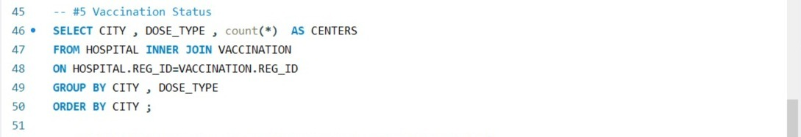
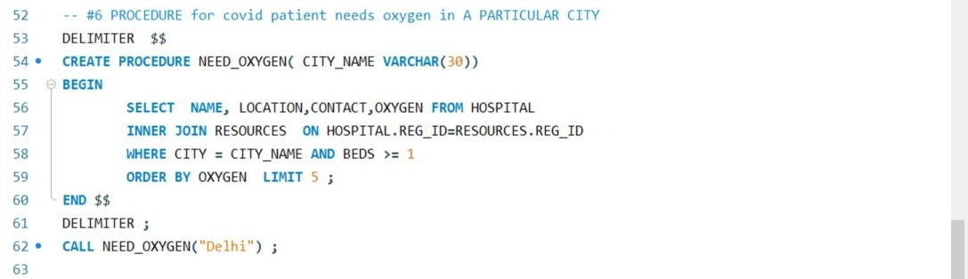
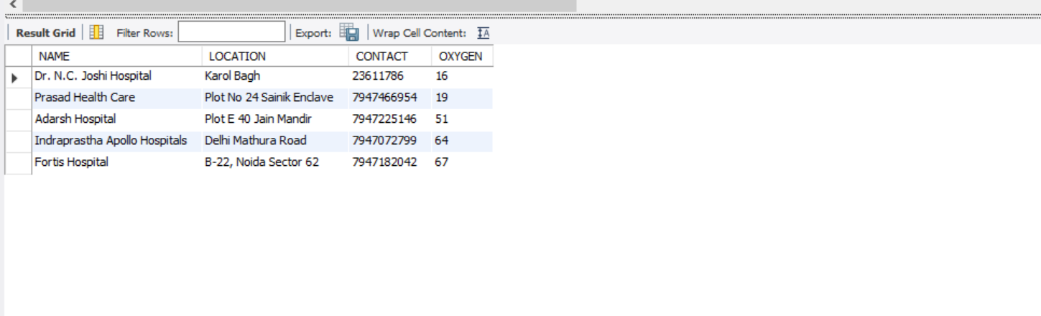

Slide 15
BIBLIOGRAPHY
https://www.medifee.com/hospitals-in-kolkata
https://www.justdial.com/Delhi/Hospitals/nct-10390288
https://www.vaidam.com/hospitals/india/bangalore
https://www.medifee.com/hospitals-in-mumbai
https://www.justdial.com/Mumbai/Private-Hospitals/nct-10390288

Slide 16



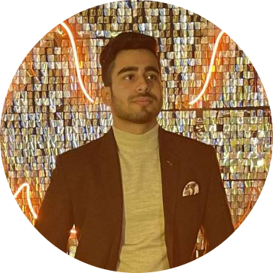
OUR TEAM
Aarush Juneja
Lovepreet Singh
Naman Sharma
Shubham Shoor

Slide 17
Thank You !

